Slide 1
Title
Find it, craft it, tell it — your story, made smarter with AI.
Brief description

Slide 2

LET´S MOVE FAST & SMART - TOGETHER
SAMPLE TILE - Project Goals
Following Microsoft’s priority use cases with Cohere/xAI, the goal of this project is to develop reference implementation scenarios that addresses real-world topics, leveraging Microsoft Azure as the cloud platform for infrastructure and AI orchestration, while utilizing Cohere’s or xAI’s large language models (LLMs) to power AI-driven capabilities throughout the processing workflow. As part of this effort SOUTHWORKS will:
Implement AI agents required to support the reference implementation scenario, leveraging:
  Foundry Hosted Agents for deployment and hosting.
  Microsoft Agent Framework for orchestration and implementation.
  Agent Memory.
  Frontier Cohere and xAI Models , like Command A+ and Grok 4.3, deployed in Foundry.
  MCP connections for scenario-specific tools, and integration with external services as needed.
  Open Telemetry (Application Insights) for logging.
  Agent Governance Toolkit.
Implement tools required to support the scenarios exposed as MCP services, including:
  RAG-based knowledge retrieval capabilities leveraging Cohere Embed and Cohere Rerank.
  MCP Services to simulate invocation of an external source.
  Microsoft Fabric for hosting the dataset
Implement end-to-end orchestration workflow, including approval steps with human in the loop through a web UI.
Package solution on a GitHub repository including architecture and scenario documentation, and scripts to deploy to azure.
Create synthetic datasets and documents to support reference implementation workflows (ingestion, classification & processing).
US | Uruguay | UK | Spain | Peru | Mexico | Colombia | Brazil | Argentina

Slide 3
Section divider

Slide 4
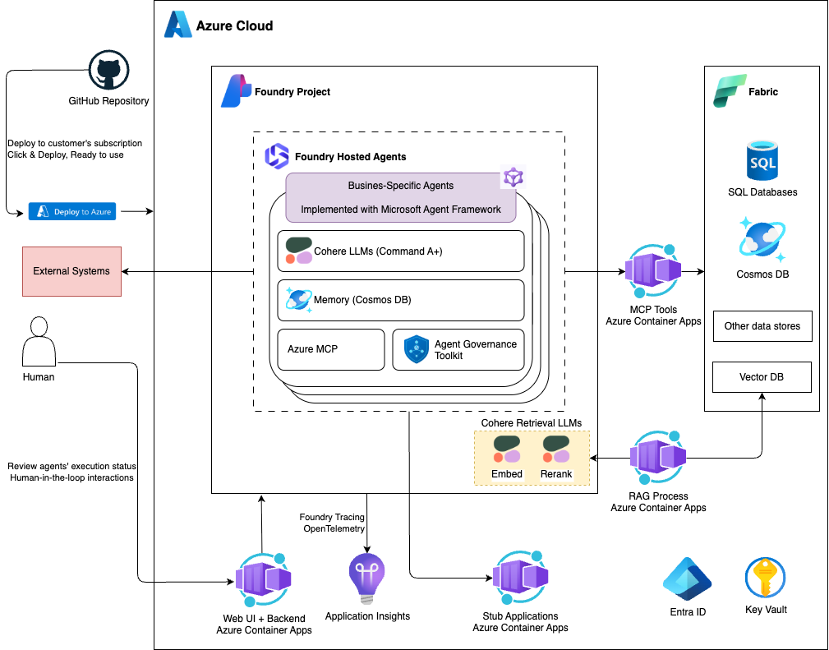
LET´S MOVE FAST & SMART - TOGETHER
SAMPLE - Architecture Diagram
US | Uruguay | UK | Spain | Peru | Mexico | Colombia | Brazil | Argentina

Slide 5
Section divider

Slide 6
Title
  Bullet
    Sub bullet
  Bullet
  Bullet
  Bullet
  Bullet
  Bullet
US | Uruguay | UK | Spain | Peru | Mexico | Colombia | Brazil | Argentina

Slide 7
Title
  Bullet
    Sub bullet
  Bullet
    Sub bullet
    Sub bullet
  Bullet
    Sub bullet
US | Uruguay | UK | Spain | Peru | Mexico | Colombia | Brazil | Argentina

Slide 8
Let’s go!

